Slide 1
Comparative Study
By: Parabhjot Singh
This is an investigation on two different artists, one from the Renaissance and the other a local Milwaukee artist. Focusing on Da Vinci and Michele Parliament, I will compare and contrast their techniques, cultural influences, and purposes present in the art pieces. Afterwards I will compare their works with art that I have produced by the criteria of thematic content, application of techniques on the medium and the elements and principles of art. Although subjective, this comparative study will attempt to answer how the art pieces came into inception.

Slide 2
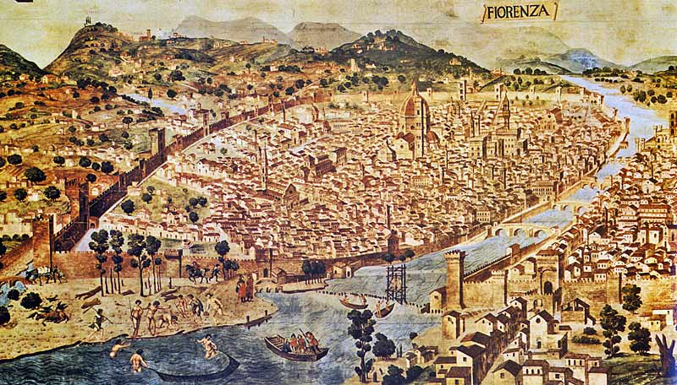
Background of Leonardo’s Cultural Significance
Morin, Donna. “Florence: The Land of my ancestry; the birthplace of my muse.”
In a society whose passions for knowledge of the Greeks and Romans were reignited, Leonardo’s interests spanned numerous disciplines. Da Vinci advocated for learning science and art in order to improve one’s art. He valued sight and considered it one of the foremost senses available to acquire knowledge through. “A good painter has two chief objects to paint--man and the intention of his soul. The former is easy, the latter hard, for it must be expressed by gestures and the movement of the limbs.” stated Da Vinci. Thus, Leonardo utilised science in conjunction with metaphysical beliefs to create his works. This being said, Leonardo dissected cadavers and animal bodies during the 1480s. The society was ablaze with rediscoveries and discoveries in numerous areas of knowledge. However, religion’s importance in everyday life did not wane.
Artists, such as Leonardo, often received commissions which required them to paint a religious subject matter. It is unknown if artists painted pieces of adoration for Christ and God out of own beliefs or the necessity for work. The art style itself was dominated with realism and efforts of creating 3D work on a 2D plane. Fortunately this was very convenient for Leonardo as he reveled painting with accuracy and attention to the world around him. Extremely detailed and engrossed in biomechanics his drawings of the heart and vascular system, bone and muscular structures, and a fetus in utero are evidence of an inquisitive mind. Although these human anatomical structures did not succeed in being painted they made up the majority of Da Vinci’s work. One of his most famous works, “Vitruvian Man” is will be referenced when discussing his great ability for merging science and art.

Slide 3
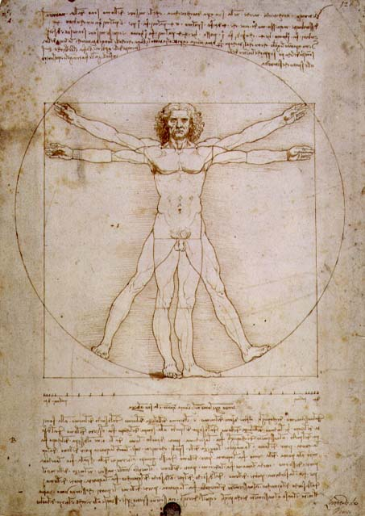
Analysis of formal qualities: Leonardo’s “Vitruvian Man”
In 1492, this piece was completed in pen, ink, watercolour and metalpoint. There is a lack of color as Leonardo interpreted this piece more as an investigation rather than a work of art. Leonardo explored symmetry and scientific balance of the human body with this piece as the midpoint of the circle is the navel of the man. The center of the man is implied to be the navel and his hands and feet touch the circumference of the circle. The shape of the square is used to compare the height of the man to the width of both his outstretched arms to signify the height and width are identical. Influenced by the Renaissance which sparked interest in human physiology, Da Vinci split up the Vitruvian man according to proportions. Horizontal lines can be seen around the knee and groin (both equal length). When measured the square and circle also have the same area, making this art piece mathematically accurate and drawn to proportion. The face is split into 4 different areas. A horizontal line intersects the nipples to ensure accuracy in drawing. The details are alluded to with lines representing the underlying muscle and bones. Rhythm is implemented with the slight range of motion of the extremities which in turn creates movement, albeit limited, of the figure. The repetition of the extremities is shown to indicate how well the figure is confined to the geometric drawings and made sense of using math and fractions.
Leonardo da Vinci, "Vitruvian Man" (1492). Pen, ink, watercolour and metalpoint on paper

Slide 4
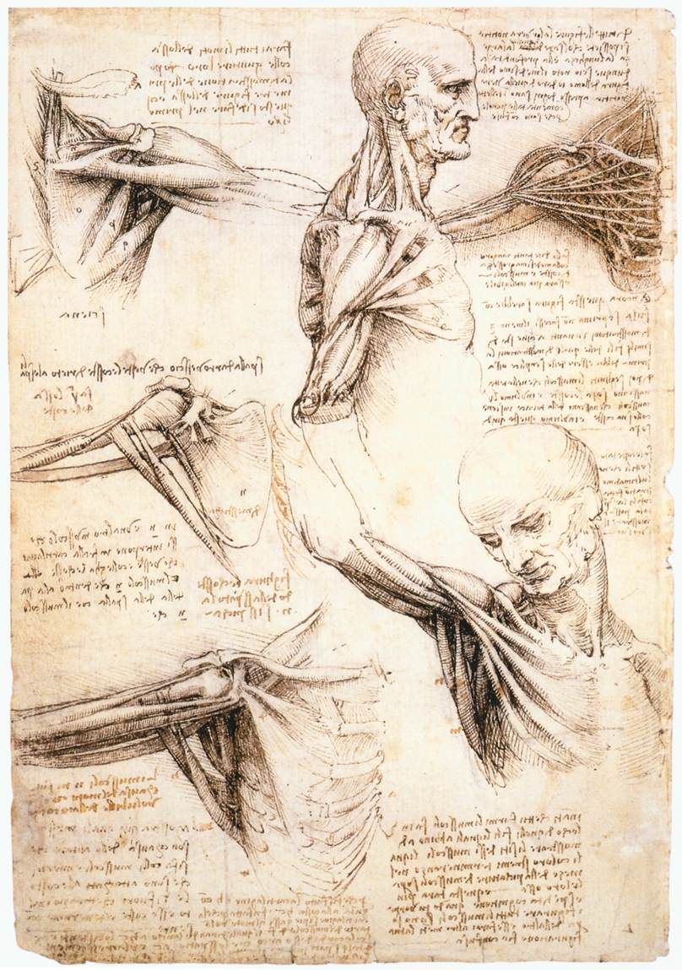
Analysis of formal qualities: Leonardo’s anatomical drawings
Leonardo’s anatomical drawings of the shoulder show his intense interest with the human body. Done in ink and black chalk, there is once again an absence of color. Leonardo utilised a cadaver for investigation of the muscles that created movement. As a major component of the body the man is shown in different poses with arms by the body or extended to show how movement is facilitated by the muscles and skeletal system. When first viewing this piece, the focal point is the upper centered man as it is the man’s completed profile with a lateral view of the shoulder. In the surrounding sketches, emphasis of the anatomy of the shoulder is created through value to indicate depth. Crosshatching is implemented to show value and depth of the sketches. The muscles are shown as cords in the top-right to show movement as the arm moves. The ball and socket joint is clearly seen. Negative space is filled with notes in Leonardo’s signature backwards writing. The writing and sketches create harmony and proper unity of a scientific investigation contingent on visual aspects. This investigation allowed Leonardo to appreciate and analyse the rhythm (shown in the many long filaments of muscle and their position)of nature and the form of man to further assist him in paintings which required this degree of realism and anatomy knowledge.
Leonardo da Vinci. “Anatomical Studies of the Shoulder”. Black chalk, pen and ink on paper

Slide 5
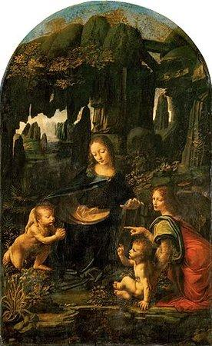
Analysis of formal qualities: Leonardo’s
“The Virgin of the Rocks”
As a prime example of the High Renaissance, Da Vinci employs sfumato, chiaroscuro, and pyramidal composition. With sfumato-the shading of hues gradually into one another- the painting receives a soft texture which allows the viewer’s eyes to flow smoothly from the emphasized focal points of the faces to the dark rocks and foliage. With the medium of oil paint, Leonardo was able to utilize chiaroscuro-side by side strong contrasts between light and dark value. This produces a solemn painting and allows for the deception of form. Pyramidal composition as the name suggests is the configuration of the personas in the painting in a pyramidal fashion. Leonardo achieves unity as Mary is seen to be at the zenith of this invisible pyramid with the others surrounding her. The piece has religious value as the title suggests. This is influenced by the society as religious paintings were very common since people were illiterate and the only propaganda that could be used was art. In the Renaissance, religion was a cornerstone of social power.
In the work, Mary has her hand on the shoulder of St. John who has his hands clasped together almost as if in a prayer. Her gaze is on the infant Christ and her left hand outstretched as a woman points to Christ. The background shows rocks and the foreground has flora. Chiaroscuro, the contrast of light and dark is used to separate the heavens for the land and the faces of the personas are illuminated in a religious light. The folds of the clothes hint at bodily movement underneath the clothing as light does not reach the deep folds.
Leonardo da Vinci, The Virgin of the Rocks, c. 1483-86, oil on panel

Slide 6
Background of Michele Parliament’s Cultural Significance
Michele Parliament has a wide array of pieces which are indicative of her great work-ethic or escape from the world. Equipped with a sardonic personality, Michele Parliament is my local artist. Works have been completed in digital collage, drawing and painting. The wide array of work seems to differ among each other and does not converge on a single overarching theme. Her guiding principle in art is to “Manipulate the things that have manipulated her.” Hence, it can be noted that her art pieces have a personal connection to her life and experiences. In this modern day and age, a person is exposed to numerous stimuli and most of that is represented in her work. There is not much information about her life besides a web page which may or may not be accurate and trustworthy.
Michele was born in 1966, she has lived her entire life in Wisconsin. She regrets the decisions that her parents influenced her to make which led her to nursing school and a life without art. She currently works as a nurse in pediatric psychology. Although her nursing school experience was not to her liking, medical subjects often appear in the art. I believe emotions play a major part in her artistic process as she has stated, “When I get pissed at the world, I mess around with Photoshop to cut/splice/layer the chaos into something that makes sense to me.” Besides, the varying subject matter of her art, Michele is influenced by contemporary artists such as Glenn Barr, Mark Ryden, etc. These artists explore fantastic notions through their art. Michele paints what she knows about and her art is a product of her 50 years she has been alive. Therefore one can posit Michele was influenced by the tumultuous and chaotic modern day era.

Slide 7
Caro de Carne Mea
This 8 x 10 digital collage presumably depicts others (male hands) that are performing an open-chest investigation of a woman who seems to be religious because of her attire. Helpless to do anything, she lets them do as they please as she suffers, indicated by the tears from her eyes and looks above for help, perhaps from God. There is a theme of helplessness and lack of individual action, waiting for a higher being to intervene. A poor example of existentialism, this digital collage employs a background using chiaroscuro as the left half is dark and becomes gradually gray. The focal point is the woman and more specifically the woman’s chest. The subject matter is the internal organs of the woman in vibrant color along with germinating flowers. The lungs are wide apart so the heart is visible. The floating hands have value and depth, rendering them in 3D but still retain the illusion of appearing out of nowhere as they are floating in space. The attire is indicative of a religious affiliation and is shown with folds and a genuine quality of fabric. Shadows indicate ripples in the fabric. Sfumato, a technique which involves gradual blending of color to produce hazy form is implemented. The art piece's origins seem to be that of the mid 1600s if it were not a digital piece. A touch of modernism and realism is added with accurate anatomy. Dull hues allow the viewer’s gaze to focus on the chest as most of the emphasis and objects is/are situated around there. In Latin the title means ‘The Flesh of my Flesh’.
Parliament, Michele. Facebook.com

Slide 8
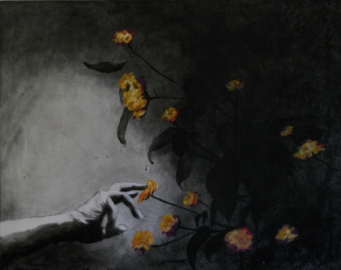
Night Garden
This acrylic and oil on canvas piece is one of the few paintings from Michele that is more open-ended and ambiguous than others. A venture into the unknown is depicted in this piece as the hand is outstretched as if reaching for something in the darkness. A eerie positivity comes from the piece with Michele’s use of contrast and color as the flowers are a vermillion compared to the grayscale of everything else on the canvas. Balance is achieved as the hand is coming in from the left and the flowers greet it from the right. Emphasis on the hand and flowers are achieved through contrast and allow these two objects to stand out to the viewer. The hand is smaller than the flowers, adding more weight on the right side of the canvas which is equivalent the other side by the addition of light value in the background on the left hand side. The gradual fade to the darkness is representative of light dimming indicating a bigger background which in this case is substantial as the whole right hand side is dark. Harmony is achieved in the piece as Michele employs the two objects of interest coming towards the middle to meet each other. The flowers are created by short dabs of what seems like oil paint as they have a greater albedo than the rest of the canvas. The short dabs also give the flowers form and allow movement in the piece resulting from how they [the flowers] are jutting outwards from the right side.
Parliament, Michele. “Night Garden”. Poignarde.wordpress.com.

Slide 9
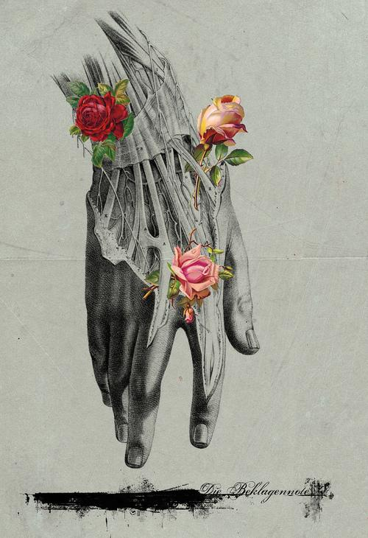
Untitled
Another digital collage, Michele concentrates on a singular object as the object of focus. The hand is depicted as limp and ‘hanging’ towards the bottom of the piece which contains the signature and a horizontal splotch representative of ink. Value is brought to the piece with the contrast of dark and light values. The light accurately hits the hand at the place where the muscles are illuminated and give the sense of slight protrusion. Farther from the surface of the skin, the hand contains tendons on top of muscle along with blood vessels on the sides. Michele did not create a background for the piece and the emphasis of color is only added to the roses which adhere to the hand, the stems sometimes twining behind the complications of the hand. The tendons are marked with small ‘x’s as if in study. Michele achieves balance with three roses that are by the hand. The roses are not prolific and exist as a subtle touch. The focal point of the piece are the three colorful roses and then attention is diverted to the hand-displayed in grayscale. Both objects are organic and coincide with nature however the complications of the hand seem mechanical when compared with the delicacy of the roses. Michele inserts texture into the piece through detail as the stratum corneum is visible.
Lee, Jones. “Michele Parliament”. Art and Science Journal.

Slide 10
Making Comparisons and Connections
Da Vinci
Both
Parliament
Uses Pyramidal configuration for organization of personas in space with oil on canvas
No fantastic concepts are explored (for example, floating hands)
Complexion of figures has a yellow hue rather than a whitish hue
Utilises harmony through multitude of colors as a way to unify art piece
The mood is tranquil as suggested by the facial expressions
Study of human physiology is explained through writing in the negative space around the sketches
Religious subjects shown through serene facial expressions
Human anatomy is relevant in both artists’ artworks and is represented through drawing and knowledge of proportion
Chiaroscuro and sfumato is utilised to bring emphasis and a smooth texture to the pieces
Pieces have writings and marks, indicating an ongoing study
Both artists’ value accuracy of human physiology to aid in realistic artwork and represent it through value and form on a 2D surface
Nature is prevalent in both and is utilised in the art as a supporting or contrasting material
Utilise the contrast between value and color to influence audience’s interest (e.g. the faces in “Virgin of the Rocks” and the colorful chest compared to the white garb in “Caro de carne mea”
“Virgin of the rocks” and “Caro de carne mea” both contain variety. Leonardo shows it through the complex background and Michele shows it through the amount of detail in the chest of the lady.
Indicate that the folds in clothing were painted in consideration of the physique underneath
Digital collages are used as well as traditional oil and acrylic painting
A sense of the fantastic
Complexion of woman in “Caro de Carne Mea” has a whitish hue
Color black is utilised to give weight to piece and is contrasted by a lighter, intense color
A gloomy mood is given off by facial expressions, and a grayscale color scheme
Study of human physiology is not explained using notes or writing. However writing in the form of a signature is present in “Untitled”.
Religious subject shown with a pained expression

Slide 11
Making Comparisons and Connections: Similarities
Both the pieces use chiaroscuro, the contrast of light and dark to give the illusion of 3D form
Intensity of color is utilised to give emphasis to a certain aspect of the paintings. In Parliament’s case the open chest and Da Vinci’s faces of Mary, St. John, and the angel
Lighter colors are used for significance of persona. This allows the viewer to differentiate between the objects with emphasis and without emphasis
The subject matter for both is suggestive of religion. In Michele’s work, the woman is looking above. Leonardo’s work presents biblical characters.
Parliament, Michele. Facebook.com
Leonardo da Vinci, The Virgin of the Rocks, c. 1483-86, oil on panel

Slide 12
Making Comparisons and Connections: Differences
Parliament uses dramatic facial expressions which convey anxiety, fear, gloom whereas Da Vinci’s facial expressions consist of serenity, peace, and neutralism.
Nature is used in the background by Da Vinci to give illusion of depth and setting that can be associated with religious figures whereas Parliament’s background is bleak and blank and only filled with a gray to black gradient which isolates the persona depicted.
Movement is shown by Da Vinci through illumination of muscles that interact with the light and Parliament shows hands that have appeared out of nowhere as they seem to be floating in space.
Several faces are present in Leonardo’s work whereas Michele’s work only contains one face (person).
Parliament, Michele. Facebook.com
Leonardo da Vinci, The Virgin of the Rocks, c. 1483-86, oil on panel

Slide 13
Making Comparisons and Connections: Similarities #2
Movement is facilitated by the muscles, tendons, and ligaments shown in both drawings.
The smooth texture of the stratum corneum is highly detailed by Parliament and in the upper right hand corner Da Vinci uses accuracy in terms of detail to demonstrate movement of the shoulder.
Value is used in both to create 3D form of the body part. This aids in understanding where the parts are located when viewed by the naked eye.
Both indicate form through their 3D qualities.
Both show variety and unity through the detailed human parts represented in an orderly and accurate fashion
Leonardo da Vinci. “Anatomical Studies of the Shoulder”. Black chalk, pen and ink on paper
Lee, Jones. “Michele Parliament”. Art and Science Journal.

Slide 14
Making Comparisons and Connections: Differences #2
Da Vinci shows the muscles in movement as Parliament has the muscles visible but without movement
Parliament utilises color to draw attention to the flowers (a motif in her work) and Da Vinci solely focused on the study of biomechanics and takes meticulous notes alongside the sketches
The content of Da Vinci’s work allows the viewer to view where the shoulder is located and what movements and how they influence the surrounding areas as Parliament only shows a hand and the wrist in one pose. How the hand interacts with the natural world is not demonstrated.
Leonardo’s work was completed by hand whereas Michele’s utilizes technology.
Lee, Jones. “Michele Parliament”. Art and Science Journal.
Leonardo da Vinci. “Anatomical Studies of the Shoulder”. Black chalk, pen and ink on paper

Slide 15
Interpretation of function and purpose: Leonardo & Michele Parliament
Leonardo Da Vinci created his works on commissions or as part of his personal investigations. Works created on commission served as an opportunity for Leonardo to practice his artistic skills. The work’s function was to fulfill the requirements of the commission. “The Virgin of the rocks” was painted as an altarpiece, once again to appeal to the society, who at that time was mostly illiterate. Religion heavily influenced Leonardo’s commissioned work (most were not covered in this study) but his personal investigations stayed as sketches and were influenced by the revival of the passion for learning. Leonardo’s “Vitruvian Man” suggests Leonardo’s interest in the human body, sciences and math. His interest in such topics was demonstrated by his more famous commissions. His works do not deviate from realism and chiaroscuro, oil on canvas, and sfumato are ever-present.
Michele Parliament’s works suggest various stimuli, however she paints flora, and the human body quite often. As she stated herself, her work is a means to take a break from reality. In this way both artists’ work serve as a representation of the metaphysical-something that may not exist. The function of her works is to utilise her medical knowledge to create artwork that is often juxtaposed with various items. In “Caro de carne mea” the hands appear out of empty space and the woman’s chest is not open but placed on top of her. Michele arranges different objects in space to achieve her message. This borders on surrealism but is not quite there yet as the human physiology is accurate and not distorted.

Slide 16
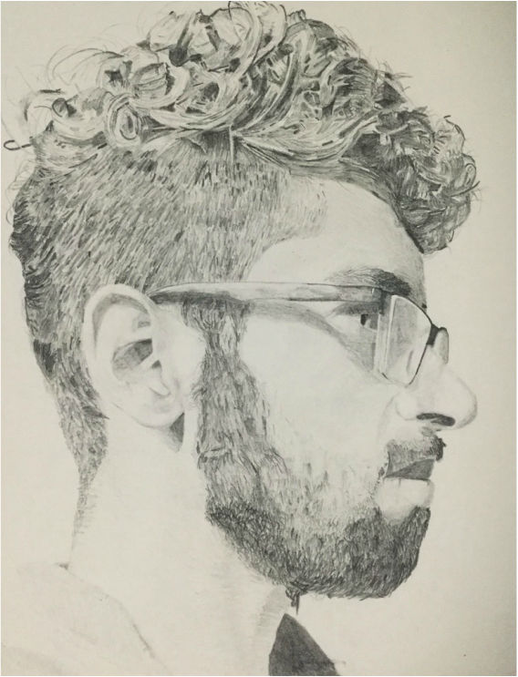
Personal Art: Connections
My art has been influenced by both the Renaissance and the local artist Michelle Parliament. In viewing their artworks I was able to extract the detail, anatomical subject matter, and utilise similarities between the color palette and techniques. Leonardo Da Vinci’s pieces on the human body have inspired pieces that contain research as well as artistic competence. From the very beginning, I have been very interested in human anatomy and through both my classes, IB Biology HL and Art HL, I was able to combine the two. Through this interaction, I often found success and an increased knowledge of biology along with my artistic competence.
The artists I have chosen to compare have centuries between them, however, certain universalities of art are consistent in the pieces. This is consistent with my artwork as I often draw inspiration from what I am genuinely interested in. The use of biology in my art gives it a realistic feel however, I combine it with different brushstrokes and mediums to allow a emotional attachment with the pieces and differentiate them from just studies of art techniques influenced by science.
Self-Portrait #2

Slide 17
Comparison w/ Michele Parliament
Inspired by the Renaissance movement and the grayscale of Michele’s artwork, I decided to create my self-portrait with detail in graphite. Self-portraits are capable of telling a lot about the artist. If done over-time it reveals changes. Michele’s art influenced me to take a step back from the world and just draw. I drew myself because it is something I know a lot about as I have completed several self-portraits. In the future, I would like to experiment with juxtaposing items on my art. This would lead me to explore how I am able to convey messages in new ways. Learning from Michele, I would also like to gather items I see daily and create a piece which displays how I see them. This, I believe, is one purpose behind art.
I did not create the piece digitally but utilised a process similar to Michele’s which involved drawing the piece. Much like Michele, I have kept the piece in grayscale to indicate the detail and level of shading to achieve varying values. Value is varied to show the interaction with light and give a 3D illusion on a 2D surface. I tried to capture every minuscule detail in hopes of realism. Through the paper used, the texture of the skin is soft similar to that of the hand. Although the muscles underneath are not shown, I utilised the interaction of my facial structure and light to display my knowledge of the muscles and anatomy underneath. The background is kept empty to create more emphasis on the subject in the center. As Michele creates movement with a hand reaching downwards, I created movement with varying degrees of value in the hair and the use of organic lines.
Lee, Jones. “Michele Parliament”. Art and Science Journal.
Self-Portrait #2

Slide 18
Comparison w/ Leonardo
I often create most of my artworks on a grid and then I lightly erase the grid where needed. I found this method to be the most accurate when one desires to display accurate proportions. Leonardo provided justification for my reasoning as the “Vitruvian Man” is also drawn with markings which are suggestive of accurate proportion. In creating accurate proportion, I was able to succeed in showing form on a 2D surface. Although I have not utilised the entire human body, I shall try to incorporate it in future endeavors. Leonardo’s artwork has allowed me to see the beauty in the construct of man. Before viewing Leonardo’s work in integrating science, math, and art in one, I would have not seen the proportions integrated into man.
As mentioned before, I used a grid to create my artwork. As Leonardo utilised the human body for reference, I utilised a reference picture which I took beforehand. Balance is achieved through the equal weights created by the facial hair and the hair on top of the head. Everything is centered on the middle point of the paper as with Leonardo’s work, the navel is at the middle of the circle. Repetition is created with the small strands of hair on side of the head. However Leonardo utilises repetition with body parts. My piece also does not contain harsh lines or writing.
Self-Portrait #2
Leonardo da Vinci, "Vitruvian Man" (1492). Pen, ink, watercolour and metalpoint on paper

Slide 19
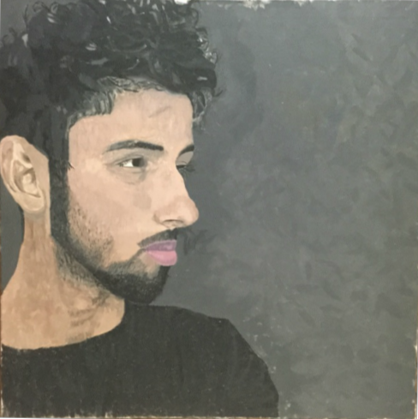
Comparison w/ Michele Parliament & Leonardo
Leonardo’s use of value and hue in “The Virgin of the rocks” guides the audience’s attention towards the important parts of the painting-it adds emphasis. Likewise, in my self-portrait, I have created a dark background and relative to it, my complexion has lighter value. The allows the focal point of my self-portrait be the face and more specifically the eyes. In portraying a person, I decide to go for a neutral facial expression as Leonardo had done. This is to accurately record the person’s face without distortions. I believe, in this way, the most information about the subject is conveyed.
Michele’s contrast of values also aided me in creating this piece as I utilised the idea of light but in an opposite fashion. Emanating from the left-side of the face, the gray is a bit darker than the rest of the background. I also emulated Michele’s use of chiaroscuro on the arm with my ear and eye in order to accurately display depth and form. The color palette for the self-portrait is dull however with minimal sheen. The flowers in Michele’s piece are vibrant and add a subtle touch of variety in the piece-something I wish I could’ve added to my self-portrait.
Both of these artists have allowed me to utilise their techniques of manipulating emphasis through color. In order to further my exploration influenced by Michele and Leonardo, I will attempt to work in oil so I am able to blend much better and allow my work to have a sheen as acrylic does not provide one. Also utilising my passion for Biology and human physiology I would love to paint pieces that depict action of the human body. This way I will be experiment with achieving realism in the context of an entire human body through chiaroscuro, varying values, contrast of colors, and sfumato.
Singh, Parabhjot. “Forward”. Acrylic on canvas
Leonardo da Vinci, The Virgin of the Rocks, c. 1483-86, oil on panel
Parliament, Michele. “Night Garden”. Poignarde.wordpress.com.

Slide 20
My Artistic Development
I utilised the contrast in value that is present in Leonardo’s “Virgin on the Rocks”. This allowed my face to become the main focus point in the piece.
All pieces show an acknowledgement towards human physiology and realism. Although my self-portrait do not show the muscles beneath the face, the light that is incident on the face indicates the facial structures such as the cheekbones, size of neck, etc. Furthermore, the proportions are correct as they are in both Michele and Leonardo’s pieces.
Blending is performed carefully in order to deceive the viewer in thinking the picture is 3D even though it is on a 2D plane. This is accomplished by gradual shading and the use of highlights on structures that jut out. Chiaroscuro is utilised to distinguish between varying depths (E.g. where the neck ends and the jaw begins).
In referring to Michele and Leonardo’s artwork, I have recognised their appreciation towards portraying the human body as accurately as possible. In several instances (the thyroid area) of my first self-portrait, I did not achieve realism as well as I would have liked to. However, in the future I will ensure I blend better by using the medium of oil to achieve gradual shading. In addition to a change in materials, from Michele I obtained the idea to scan in my drawings to photoshop and juxtapose ordinary objects. In doing so, I can give my works the points of interest Michele does (E.g. the roses in “Untitled”).

Slide 21
Bibliography
Biography.com Editors. Leonardo da Vinci Biography. A&E Television Networks. Retrieved December 15, 2016, from: http://www.biography.com/people/leonardo-da-vinci-40396#humble-beginnings
Harris, B., Zucker, S. “Virgin of the Rocks.” Khanacademy.com. Retrieved December 15, 2016, from: https://www.khanacademy.org/humanities/renaissance-reformation/high-ren-florence-rome/leonardo-da-vinci/a/leonardo-virgin-of-the-rocks
Lee, Jones. “Michele Parliament”. Art and Science Journal. Retrieved December 15, 2016, from: http://www.artandsciencejournal.com/post/39504281386/michele-parliament-in-the-about-section-of-her
Leonardo da Vinci. “Anatomical Studies of the Shoulder”. Black chalk, pen and ink on paper, Royal Library, Windsor. Retrieved December 15, 2016, from: http://www.wga.hu/html_m/l/leonardo/10anatom/3should1.html
Leonardo da Vinci, "Vitruvian Man" (1492). Pen, ink, watercolour and metalpoint on paper, Gallerie dell'Accademia, Venice. Retrieved December 15, 2016, from: http://witcombe.sbc.edu/davincicode/leonardo-vitruvian-man.html
Leonardo da Vinci, The Virgin of the Rocks, c. 1483-86, oil on panel, Louvre, Paris. Retrieved December 15, 2016, from: https://www.khanacademy.org/humanities/renaissance-reformation/high-ren-florence-rome/leonardo-da-vinci/a/leonardo-virgin-of-the-rocks
Morin, Donna. “Florence: The Land of my ancestry; the birthplace of my muse.” Blogger.com Retrieved December 15, 2016, from: http://donnarussomorin.blogspot.com/2012_03_01_archive.html
Parliament, Michele. Facebook.com Retrieved December 15, 2016, from: https://www.facebook.com/poorlyselftaughtartist/
Parliament, Michele. “Night Garden”. Poignarde.wordpress.com. Retrieved December 15, 2016, from: https://poignarde.wordpress.com/author/poignarde/page/331/
Parliament, Michele. “You’ve been schooled.” Blogger.com Retrieved December 15, 2016, from: http://micheleparliament.blogspot.com/2015/11/youve-been-schooled.html

