Slide 1
Planning
How initial ideas have been developed; how have you developed your work further
Critical investigation of artist; how it has influenced my initial ideas (end part 1)
Experimentation and manipulation (mostly process)
Reflect on acquisition of skills, if goals were met or not, and development as an artist (End part 2)
Make it look and sound artsy
3 paintings, 3 sculptures. 3 digital, 1 block print, 1 dry point
Edit all content. Add pictures.

Slide 2
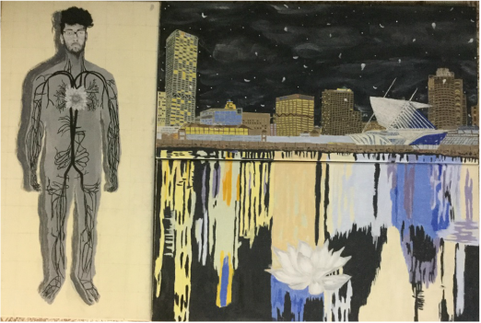
The project was to be one that is say the 'masterpiece' of my junior year. The implications and meaning should be personal and have relevance to me. My goals were to portray how I viewed myself, how the city affects me, and how I affect the city. Brainstorming and toying with ideas for the first few days, I knew immediately what I wanted to do. At first, I thought I do not affect the city at all since I am just an individual but when I delved deeper, I realized that every action has a reaction whether that reaction be insignificant or powerful. To display the butterfly's fragility I used my body as the vessel for a blooming lotus flower. The colors represent the binary opposition which everyone carries inside themselves. The white lotus flower has black roots that are in an accurate representation of a human's circulatory system. The heart is replaced by the lotus flower which is the accumulation of all feeling in the boy's chest. Instead of the roots being protected underneath the earth, they are exposed as if they are the ones protecting the lotus flower. For the other two canvases, I decided to portray my effect on the city and it's effect on me by deciding to paint the Milwaukee Skyline with the recurring lotus flower in the form of petals. For the last canvas in this triptych, the lotus flower is resting on the water outside the city limits.
Frida Kahlo displayed graphic human anatomy as a means of a testament to her emotional suffering from a life where health was significant. That attracted me very much since I too wanted to focus on emotions. Hal Koenig is a local artist that uses his architectural skills in painting city landscapes. I visited his art gallery and found out that he freehands most of his work. His work aided in the detail I desired to put in my painting. The city is full of colors and I'm glad he chose such a wide palette. When one thinks of the city at night most think in two colors yellow and black, but I wanted to focus on the true colors that are evident at night. (more about Frida and how it affected me)

Slide 3
I began my work painting the canvas an off-white yellowish hue to indicate the color of parchment. By gridding out the first canvas I formed an outline that was then filled with a base color, gray. Now I had to make sure the circulatory was represented with an accuracy. I began by freehanding the veins from a reference photo in my IB HL Biology Textbook. The sketching definitely avoided any mistakes that could have occurred via a slip of the hand or carelessness. From there on I used a round size 1 paintbrush for accurate tracing of the pencil lines. The flower was painted after I had formed three hues of white. This allowed me to add depth and a sense of 3D to the flower. The face was made with same technique and long sinuous strokes were practiced for the hair. I followed the same method for the city and the water reflections.
The buildings could have been done with great ease had I decided to paint them solid off-black and then add yellow squares to represent the lights. However, I had to display the city accurately so I used various hues of brown and grey. Mixing the color definitely came easier than the first time I was painting my self-portrait, Forward. However, perspective became difficult as I had to add the numerous floors of the buildings. I then knew that I could not be lazy and freehand the floors so I used a ruler for those as well. After I made sure my edges were clean I focused on the sky which was just black at one point. I used a rag to spread white paint. These created wispy clouds. From there I used the round size 1 brush for distant stars and gracefully falling petals. The Art Museum designed by Santiago Calatrava was difficult due to the many details it harbored. I used pen and a ruler for the lines and different hues of white. Once again, outlines in pencil were done before using paint. The rocks were created with dabs of paint and the reflections required long paint strokes. The reflections at first were completed very terribly due to the thick texture of the paint. I learned that I should mix the paint with more water for a smoother look and it worked! I kept a spray bottle of water close by to keep my palette from drying out since working in acrylic is a race against time. This worked wonderfully. However, the third canvas took extremely long due to my mistakes.
This piece was completed successfully. What I wanted to convey was conveyed. The end result matches with what I envisioned in my mind. The goals were met however, I could have done better on some of the techniques. Using a rag to create the clouds was a mild success. I wanted the clouds to have a softer feelings. The clouds need a more defined value. The two-point perspective was also sketchy as I did not have points I was tracing every line to. One failure that stands out to me is on the very first canvas. The gray body looks flat and not 3D which was not what I was aiming for. Attempts were made to fix this with the darker gray shadow but to no avail. Overall, I believe I captured what was in my heart on the canvas which I believe to be a great success but the techniques were not performed with proficiency I expected from myself. (mini-conclusion at the end of every piece)

Slide 4
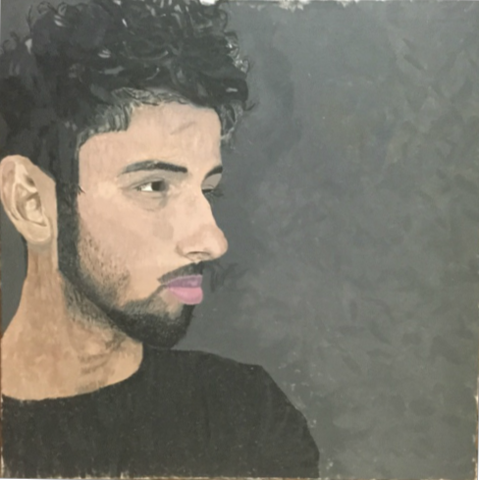
I was not planning on doing the Impressionist movement. I was lost on what to do. However, a recent event in my life brought emotions that I wanted to convey through my art. This was a lengthy and an arduous process. I did not have access to a projector so I drew a 8x8 4.5x4.5 in. squared grid on which I transferred the image by hand. I had only realized too late that I did not apply a background color over my gesso. I was wondering if I should go over my sketch and then I will start over but that seemed like too much work. After the sketching was completed, I made a gray that I applied to the background with short brushstrokes. As I was applying the gray, I realized it was too dark and I asked myself "What are you doing?" I hated this piece. It had started off to a bad start. (PP BREAK)I looked at the painting and observed what the technique was. I did see the short brushstrokes and the blending was apparent. After a while, I started painting meticulously but I was only on my t-shirt. I had implied lines where the black was intense and in areas where it was not so. I used a 1/2 in. brush to give my work detail. The technique seemed to leave a lot of bare spots of gesso showing through for me and I disliked that very much. It was at this point in this that I realized, I had messed up. Big time. Monet's painting was in oil paint and here I am painting in acrylic. This painting was going even worse than before. I continued to paint however, setting goals for myself each day. When I got to the hair, I mixed a slightly large quantity of dark black that I would use for the bases of my curls. I applied that paint anywhere I saw it on my picture and then I made a lighter black, a grayish color. I used that to create the highlights where the light hit my hair and showed the texture of colors. The bare spots where my hair was short and showed through to the skin, I kept white till I started working on the face so I could blend it together with my complexion. I was liking how the hair was turning out.
This piece was inspired by Claude Monet's Self Portrait with a Beret. The piece is originally oil on canvas and the forms are blended. Outlines are not visible and the piece has a lot of movement. I picked Monet because I wanted to leave an impression of what and how I was feeling at the time of this painting. I wanted color to represent and convey emotion. Most of all, I was enthralled with the idea of Impression that change is always occurring. Despite everything going on around me, I have to keep on moving forward. I also took another major Impressionist painter as inspiration. Degas would have his famous dancers cut off at the edges of the painting. I recreated that with my body off to one side and the cut off hair.

Slide 5
I was not planning on doing the Impressionist movement. I was lost on what to do. However, a recent event in my life brought emotions that I wanted to convey through my art. This was a lengthy and an arduous process. I did not have access to a projector so I drew a 8x8 4.5x4.5 in. squared grid on which I transferred the image by hand. I had only realized too late that I did not apply a background color over my gesso. I was wondering if I should go over my sketch and then I will start over but that seemed like too much work. After the sketching was completed, I made a gray that I applied to the background with short brushstrokes. As I was applying the gray, I realized it was too dark and I asked myself "What are you doing?" I hated this piece. It had started off to a bad start. I looked at the painting and observed what the technique was. I did see the short brushstrokes and the blending was apparent. After a while, I started painting meticulously but I was only on my t-shirt. I had implied lines where the black was intense and in areas where it was not so. I used a 1/2 in. brush to give my work detail. The technique seemed to leave a lot of bare spots of gesso showing through for me and I disliked that very much. It was at this point in this that I realized, I had messed up. Big time. Monet's painting was in oil paint and here I am painting in acrylic. This painting was going even worse than before. I continued to paint however, setting goals for myself each day. When I got to the hair, I mixed a slightly large quantity of dark black that I would use for the bases of my curls. I applied that paint anywhere I saw it on my picture and then I made a lighter black, a grayish color. I used that to create the highlights where the light hit my hair and showed the texture of colors. The bare spots where my hair was short and showed through to the skin, I kept white till I started working on the face so I could blend it together with my complexion. I was liking how the hair was turning out.
Definitely the toughest part of this painting was getting the right complexion. I know for a fact that I spent more than an hour blending colors together. It did not help that I had cheap paints that were thinner than water. Eventually I would get the correct skin tone only to place it on the canvas and it would look terrible. I applied many brushstrokes and this way I could create value and eventually get it right.I was successful in this project. I feel like the piece overall shows the detail I wanted and envisioned. The complexion could definitely use more help and more detail never hurt anyone. If I am to talk about the Impressionist technique I believe I did not do such a good job. It may be that I was not working in the correct medium but still, it needs a lot of work. I like how the face becomes the main focus in the piece due to all the other dull and dark hues. The skin tone by comparison is the lightest and that should catch the viewer's attention. I want a question to arise on the facial expression. "Where is the boy looking?" or "What is he feeling?" If those two questions make their way into the viewer then I am content.

Slide 6
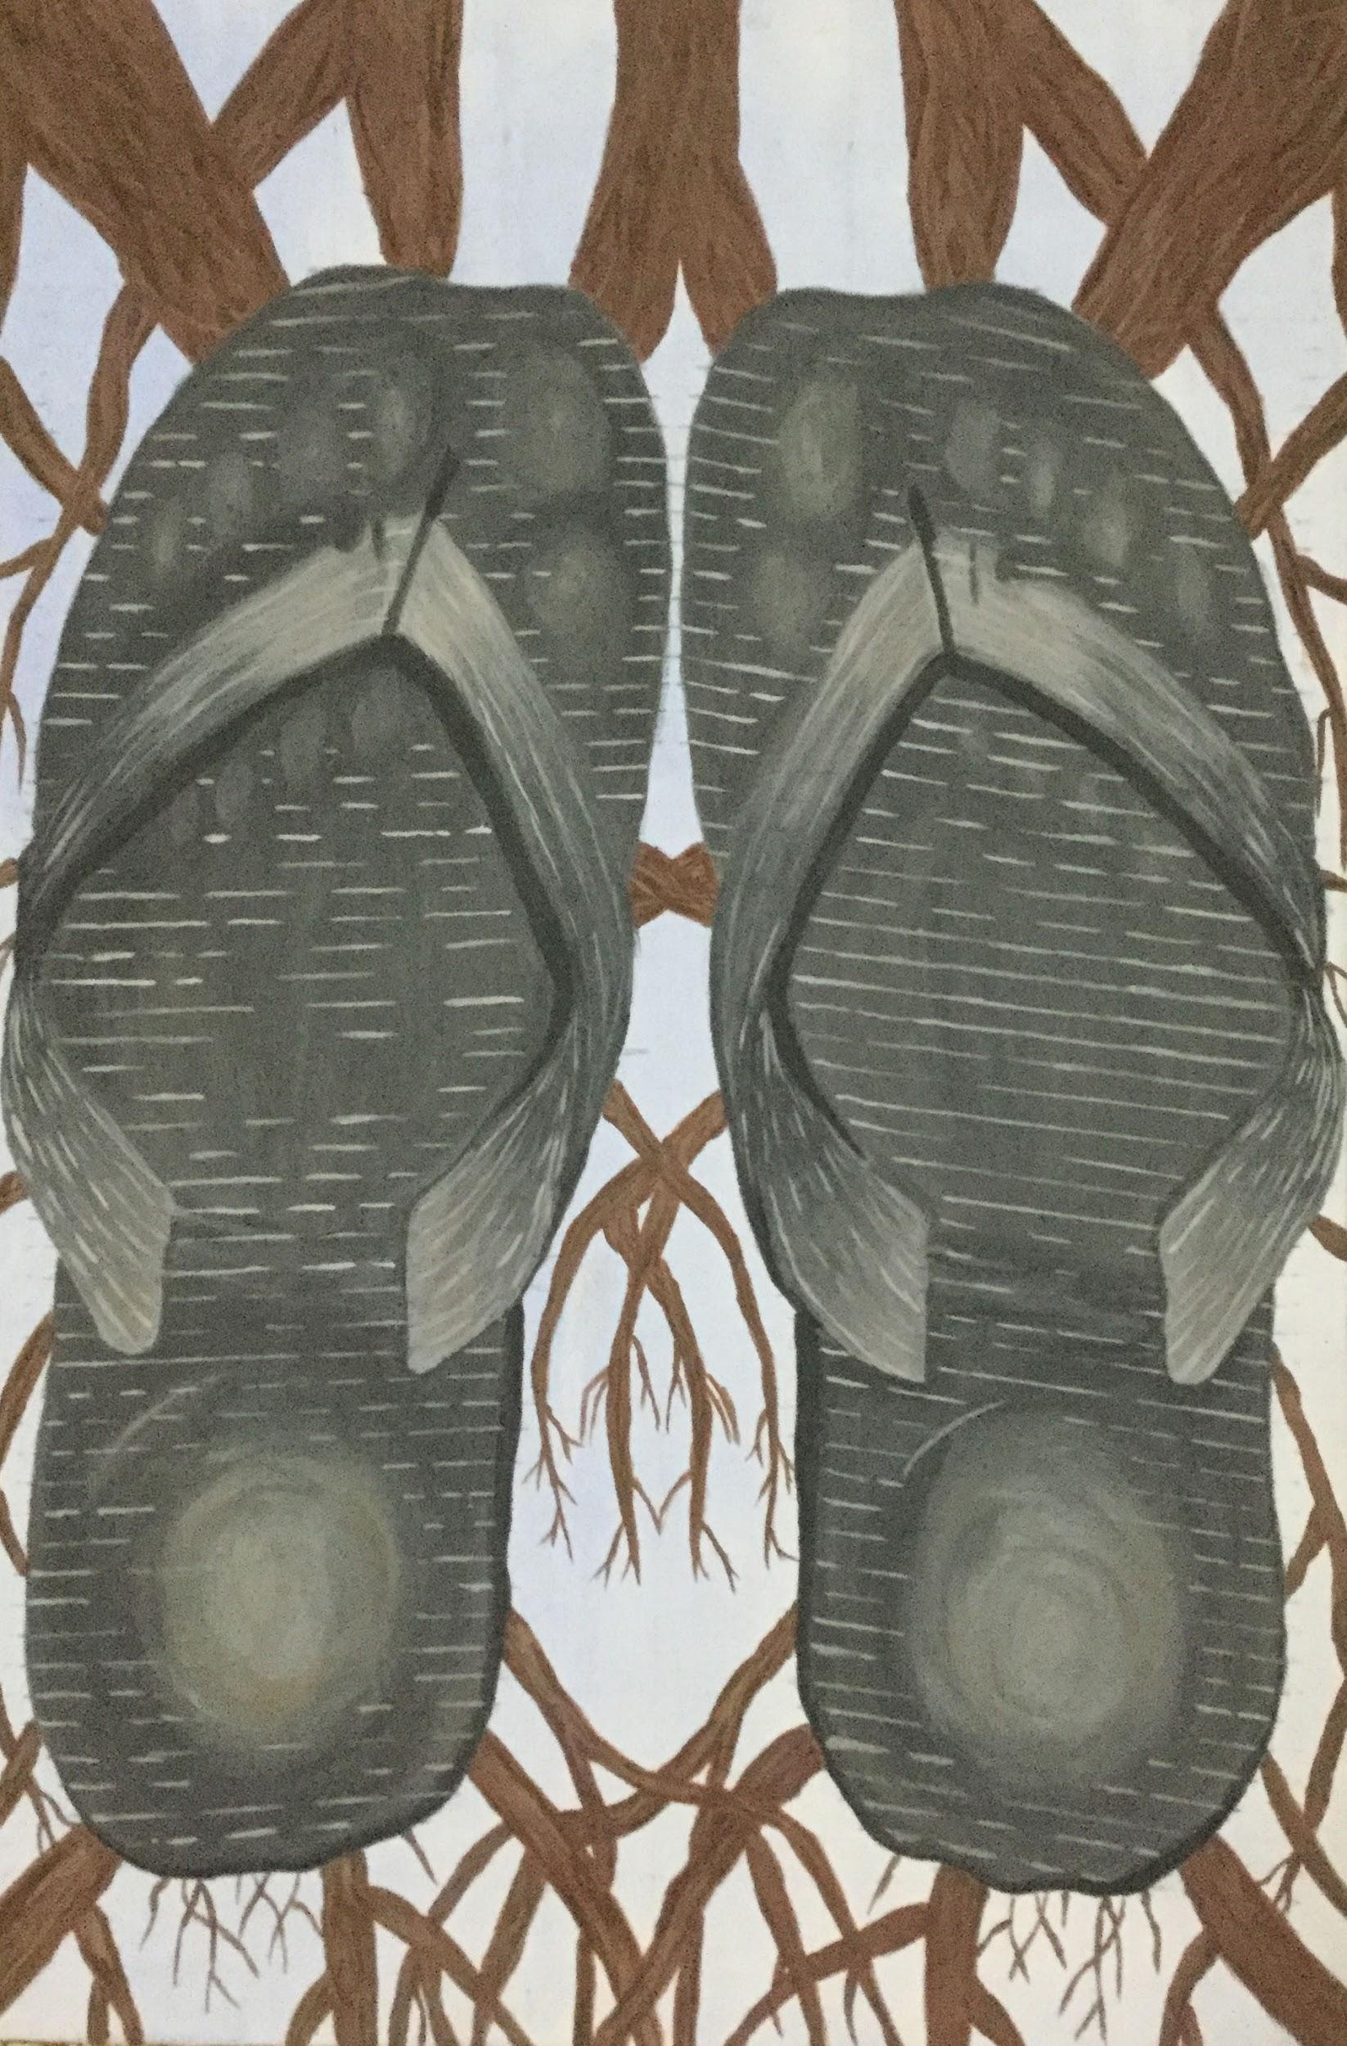
Before drawing the grid, the gesso on the canvas was thin so I applied a watery coat of blue. Afterwards I drew a grid to draw one half of my reference photo. The right side was just a reflection across the y-axis. There after I went in with a light gray coat for the base of the chappala, not painting the straps. I had to give the footwear a personality and a story and to do so meant visualizing the environment that they inhabited. The footwear were carefully situated precisely how I wanted. Now I had to add personality by adding the wear and tear of long term wear. I drew the ends beginning to erode as well as the top. Then I added slight rips on the apex of where the strap lies between the toes. I added a light gray coat for the base and then went in with darker shades of gray towards the edges of the base and the strap, places in shadow.
Edouard Manet often known as the instigator of the Impressionist Movement developed a style known for blocks of color and playful light and form. Although Impressionists may have painted still life's for practicing their new technique, choosing what to paint was still an indicator of the society at that time. For example, the wealthy populace would have still lifes of flowers as they could afford to have them in the estate. With the medium oil on canvas, thin under layers could be applied and on top, more vibrant colors creating contrast and movement which gave the subject movement. Manet's subject was a lemon on a plate which he situated to the offhand right space. The background is dark as if to draw all attention to the lemon. A peculiar subject, the lemon, the motive behind it could be interpreted several ways.

Slide 7
The paint was easy to work with this time around as my previous experiences led me to mix a little bit of water into the paint for better spread ability. Working with a larger piece such as this, I kept running out the specific tone of color and having to remake it. However the second time around the color was always slightly off. This was troublesome as the chappala were in grayscale. For blending once again I resorted to adding small strokes of paint so that when viewed further back the color would blend. When adding the 1/2 inch marks I had to make sure I was marking it accurately as the canvas curved towards the ground in the center.
To signify wear I added highlights where the heel, tarsals and the metatarsals should be. If light is hitting the chappala from above the areas of wear would be the areas of highlight. Now that I had all the paint on the canvas I concentrated on the background which in hindsight was a bad idea. The whole point of still life is for the viewers attention to be led throughout the piece by me, the artist. I foiled that by adding roots as my background. I started off with thicker roots towards the top and they were slender by the time they reached the bottom of the piece. I didn't want a lot of branches to distract from the footwear. To keep the line of symmetry what I did on one side I had to replicate on the other. To add a more realistic feel to the branches I added small sinuous strokes of different tones of brown. This texture allowed the roots to become gnarled with age. My focus was once again on the chappala as I blended the lighter and darker colors for a smoother interpretation of the light and the strap's curvature. To further display wear I applied texture to the footwear by lines. In order to do this I marked 1/2 inch intervals the entire length of the footwear. Now I slanted the lines and reflected the action to the other chappal. The lines were dashed where wear had eroded the protruding rubber design. To resemble dirt I added a watery coat of light brown where they would normally be.
If the footwear is regarded in isolation I believe I did well incorporating a story into an inanimate object. If the background is also taken into consideration then I do not think I did so well. It would've been better and less distracting to the still life if the background was completely black. I plan on changing this sometime in the future. The message I wanted to convey with this piece was that "flip flops" as some call them are not always an item of luxury that one can wear to the beach or regularly wear in the summertime. To some flip flops are all they have because they are cheap and shoes are expensive. I wanted to challenge such societal thinking. However such footwear does not enunciate that a lower class does not have the qualities of a higher class. The footwear is situated with care as the owner has dignity and respect for the chappala. They are grateful for what they have. Seeing chappala outside of households and more importantly in front of the entrance to a temple is what inspired me to create this piece. Ever since I was younger my mother would always advise me to set down my chappala with care.
(do we incorporate our ACT questions??)

Slide 8
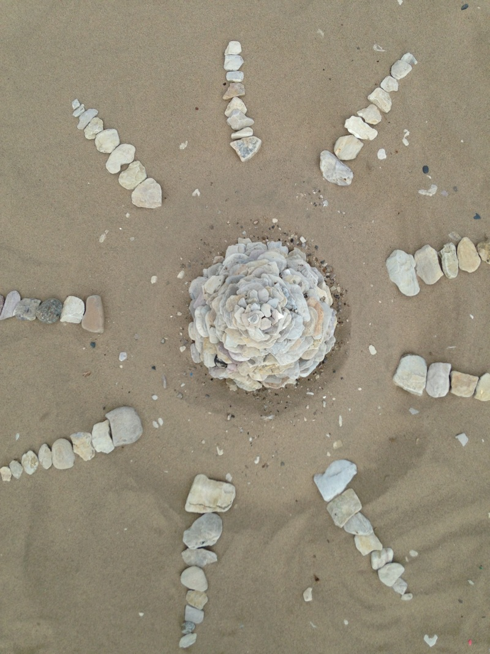
This project was originally to be completed overseas in India since I took a trip there to visit my family. However, there was not enough time and the environment there was not mixed media friendly as there was a lot of garbage in and surrounding my village. I, however, did take the idea of nature and a home into consideration and I knew I wanted to do something that sends that message. As a person who immigrated here when I was six years old, I know that I have two homes. Those homes are here, in Milwaukee, but in India as well, where most of my family lives. I saw the struggles and mud houses in my village and decided to incorporate them into this mixed media piece. I had all these ideas but no idea on what to do exactly. I went to Lake Michigan one day, and decided to brainstorm with my friend. I had the idea of exploring the binary between beauty and ugliness. Now these are broad terms and they mean something different to each and every person. As I looked around the sand and pebbles, I saw pollution. There were a few plastic bottles and just trash laying around in the sand. I saw pieces of driftwood that if without, would make this a wonderful, clean place for everyone to enjoy. Right then (thanks to my friend Daniel), I had the idea to build an egg, something I knew Andy Goldsworthy had also done. I began to make the depression so the bottom of the egg would have support from the sand and would differ from Goldsworthy's Cairn. It had started to storm right there and I had stop working. I went home and sketched out everything that I was planning to do with this project.
Andy Goldsworthy's interaction with nature is a major inspiration of this sculpture. The rocks resemble strength and fragility in the shape of a flower. Flat rocks were found by the lakeside. There is contrast with the rest of the scattered rocks as it resembles a flower inhabiting a place where it is not meant to grow. In a foreign land, the flower must be taken care of so that it's beauty can be seen by all. Similar to the flower, our world must also be taken care of.

Slide 9
For the project, technique was not a great challenge. I had to find flat rocks for the foundation of the egg to be strong and serve as a cornerstone for the rest of the piece. Walking around the beach, I found flat rocks and carried them back to my workstation. I placed one flat rock in the center and went in a spiral outwards since an egg starts off thin on the ends and widens towards the middle. The sand helped in forming this shape as intended. I had to work in small flat rocks and so this took quite a long time. Frequent trips picking up rocks hurt my back because I utilized incorrect body mechanics (my back ached for a week). Towards the middle of the project I began to think strategically as my experience accumulated. I found bigger flatter rocks that I would then place on the outskirts of the egg and the smaller flat rocks filled up the middle. I placed the rocks carefully and leveled out any difference in height of neighboring rocks by using the support of smaller rocks underneath the bigger ones. The egg was attempted to be as flat as possible to attain the height desired. When it was completed, miniature pebbles from near the water served to add texture to the piece as I scattered them along the piece and the surrounding sand. Later on, after realizing this is no longer an egg, I decided to put lines of rocks from biggest to smallest to represent the leafy, open structure of a flower. When photographing, I made sure to include the serene quality of the water and pictures of the Milwaukee skyline were at an impossible angle so those could not be captured. Auto-focus was used on the iPhone 5 back-camera for detail shots and focusing on my cairn.
The world we live in has problems. Whether the population is aware of them or not, they do exist and it's time we started taking action. Global warming is very much real and the earth is warming up, with major glaciers melting, raising the sea level. In India, the groundwater is lowering, prohibiting the use of sugarcane for manufacturing sugar. Pollution created by us humans is increasing. Meanwhile, we sit blindfolded with connections to social media. The world is connected more than ever but us humans do not make use of it for betterment of our earth. A Paris meeting, COP21, was held to discuss solutions to these issues. I am glad the world is taking these issues seriously but it is time I facilitate the process as well by making those unaware, aware. Through this piece I wanted to convey that in order for the beauty of this planet to be conserved; in order for us to live in harmony with this planet and avoid problems for our future generations we need to step up now. I am merely one out of the 7 billion humans that populate this planet. I can't make a big change but if I start small, maybe these ripples will turn into waves.
This project was completed successfully. I succeeded in conveying my message and the photography turned out to be nice. I was disappointed at first that the sculpture did not turn out to be an egg because my message with the egg would have been stronger but a flower serves the purpose as well. I should try to perfect my technique next time so structures that require symmetry such as an egg could be completed. The flower has unity with its form and eyes are free to travel around the piece and take in the background as the lines created by the rocks are jagged and sort of organic. The symmetry of the photograph taken from above does give a sense of balance as one side looks identical to the other. Some photos could be vastly improved. Techniques on photographing should be taken into account. Incorrectly, using the "rule of thirds", I kept my sculpture in the middle of my photos when I should've picked a spot for the eye of the viewer to enter and exit the photograph. This could have been done by placing the subject in the intersection of the lower right corner. The sculpture could have ended in the intersection of the upper left corner. Overall, I believe this was a new, extremely hands-on project that expanded my horizons and made me explore an unfamiliar medium of art, found object.

Slide 10
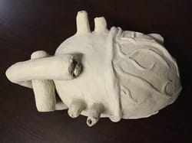
I wanted to integrate science into my art and I found that creating a clay sculpture would be a perfect way to do so. I take Biology HL and during the 2nd semester I know we will be investigating human physiology. In preparation, in my summertime I read up on the human heart and now I will be creating this sculpture. First, I decided to refresh the anatomy of a heart and I did so by sketching and labeling a heart. I also had to figure out how big I was going to make the sculpture and decided on a 140% size relative to an average human heart. This way I would be better able to work on the details. I also thought about adding a butterfly that would perch on the aorta but did not have enough time to construct one. I feel as if it would've definitely incorporated another aspect of nature much like in Michele Parliament's work (an artist in my comparative study). I had to make sure I create the sculpture well as I did not want my hard work to be undone in the kiln.
Therefore I revisited the fundamentals of clay sculpting such as slipping and scoring for attachments and the importance of hollowing. I was confronted with a challenge in the very beginning which was 'How do I hollow out the heart?' I thought about created the two halves separately and then putting them together however this would create dents in the body of heart as I working on the details. To solve this problem, I created an armature out of crumpled paper and tape. I created the armature to be 3/4 of an inch less in every dimension in order to compensate for the size increase once the clay was added on. Before starting, I also had a concrete plan of how to complete the Vena cava, pulmonary artery and the aorta. A friend of mine told me I could use cardboard and if it was tough to work with I can always apply water to make it malleable. I recycled a tissue box and created the rolls for the attachments. To create them bigger or smaller I corresponded with the right amount of cardboard.
Leonardo Da Vinci was a Renaissance artist from 1452-1519. He was apprenticed to Andrea del Verrocchio where he learned the trade of an artist. Although throughout his life he did not create many finished works, Leonardo's interest ranged from physics to painting. This wide spectrum took up most of Leonardo's life. He studied in great detail and noted the observations accompanied by detail sketches in a few notebooks. He is famous for the Mona Lisa and a few other famous works but his sketches are what intrigues me. I feel we share similarities in the sense that both of us are drawn to science and art. For this project I decided to integrate the two to further my understanding of the human body. I sculpted a human heart to familiarize myself with blood flow and the anatomy of heart. One of the sketches indicate Leonardo also studied the human heart (back when it was not widely known/ investigated). I plan on using the detail and science Leonardo put into his sketch by incorporating it in my sculpture. I plan on making the heart proportional to an actual human heart and have decided to include all of the major anatomical features.

Slide 11
Now that I had done all the preliminary tasks, I wedged the clay and stuck it onto my armature, using the aid of a knife to spread it. In doing so, I made sure to keep the clay from drying out by spraying water occasionally. When the shell was completed I went back with the knife and made holes where the attachments were going to go. I wet the rolls of cardboard and situated them in the holes. Afterwards, I added clay with the knife, making sure to really work it because air bubble could be disastrous. Creating the aorta and the pulmonary artery was an identical procedure. After, roughly completing the heart, I went over it smoothing out areas and removing excess clay or adding necessary clay in some areas. Then I put the heart aside with a moist paper towel on top to prevent drying and starting rolling out thin coils of clay. These were attached using scoring and water. I made sure to include the marginal artery, the small and great cardiac vein and others that I had labeled on my heart sketch. Using my fingers, nails, and the knife I smoothed out the veins to make them look natural and not just coils. After the sculpture dries, I plan on firing it in a kiln and then glazing it to further my understanding of a heart.
This critique is not able to be fully completed at this time. However, commenting on the first part of this project, I feel as if I was successful in emulating my artistic inspiration and achieving my goal. I desired to learn more about the heart and was able to. Leonardo Da Vinci created a sketch for his heart studies and I feel that a sculpture will be able to aid in greater understanding, especially when it is fired and glazed with different colors representing the blood flow. During the armature process, I made the body too large and did not compensate for the addition of the aorta, which increased the height by 3/2 inches. Ergo, I did not successfully achieve the proportions which is disappointing. In addition, some veins look lifeless and flat. I wanted to create them with more fluidity. Since this was my first time working with an armature, there are definitely some aspects I can improve on. I would like to work on creating organic form which would allow me to attribute smoothness and movement to my sculptures. In hindsight, I could have added more texture to the heart as actin and myosin are secondary proteins with linear forms. This means the heart body should have lines to represent muscle. To conclude, the heart resembles my sketch and is accurate (except for the absence of texture of muscle), the two goals I was aiming for.

Slide 12
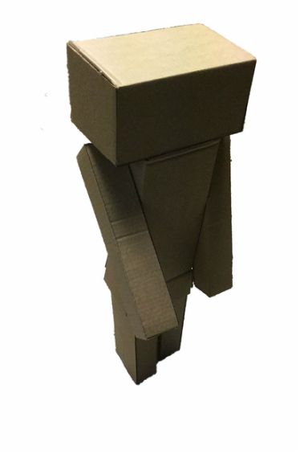
This is one of the rare times I actually knew from the get-go what I was going to do! As the project of organic vs. inorganic was being explained to me, I started thinking about what I would use and do. From an exposure to a painting on cardboard which is hung in the hallway near the art class, cardboard seemed a very appealing material for me to work with. Later on I used the idea of these box-humans which I have seen on the internet over the past few years. The idea of this project was very refreshing and something which I sort of center my work around. There is a binary opposition with industry and nature. In order to explore this I decided to make a sculpture out of cardboard of a cardboard human. Already the sense that it is a human figure made out of these straight lines implicates the structure of a building and makes the viewer think of a cityscape. I sketched out my little person to get a sense of what I would be doing. I knew I had to connect the cardboard somehow and in order to accomplish this I thought of chicken wire or even long brads so the cardboard human would have movable arms and legs. The artist I chose for inspiration was George Segal. George Segal works in plaster bandages and casts to create life size human figures. As part of the pop art movement, the work is industrial in a sense but the sculptures of humans make the work organic unless one associates industry with humans. He keeps detail to a minimum which gives the work the illusion of being an apparition. This is conveyed in my work as well with the absence of detail. ​
Inspired by Pop Art artist George Segal's, Woman with Sunglasses, a cardboard human is made. This is to evoke thought about the seemingly humanoid cardboard structure. The straight line and harsh corners give the element of industrialism whereas the human resemblances suggest a more natural perspective. Flowers are added to the work in order to erase the boundary which separates nature from industry. The hole represents the origin of the industrial aspects in everyday life. (take a new picture/complete)

Slide 13
After some amount of research, I found that the best way to connect cardboard pieces together was through wood glue. I was grateful for this as this would make my creation come to life without the obvious jutting of chicken wire or morphed cardboard around the edges due to the intertwining with the chicken wire. I obtained a lot of similar cardboard boxes from my local grocery store. The similarity in dimensions of the boxes aided in making the rectangular prisms. Using a box cutter, the box was cut and then separated into groups. I knew to make the arms I would need 4 congruent facets. For the legs and head I would like 2 pairs of congruent facets. The body was constructed first as I only needed to attach one side to it. Liberally applying wood glue, the pieces must be held together for a minute before properly sticking. Due to this property, the project was time consuming but later on I found that some pieces could dry while I worked on another aspect of the humanoid.
A fairly straightforward experience was derived from this project. I definitely grew more comfortable with the cardboard as I spent more time with it. Cardboard is extremely versatile but the disadvantage of it is one cannot make curves with it due to its inflexibility. This was not an issue in this project but if I work in cardboard more often, I may run into this challenge. Sometimes as the glue would be in the process of drying, the cardboard being attached would lean towards one side. Cardboard can be seen as a beginning to working with plaster as it requires patience and a sense of the three-dimensional end project you will receive.
George Segal's work was not entirely captured in the piece "Cardboard Human". However aspects such as minimal detail and found object were used. This very much looks like a result from the pop art movement which is what I was going for. At this moment, I can say that I had partial success with the piece. I should make better attachments and my dimensions can always be better. The humanoid turned out taller than expected. In the future I would also try not to use a binding agents but maybe tacks and brads so the humanoid can have function and mobility. This piece is meant to be seen with nature in the background and due to time constraints the photography does not allow this.

Slide 14
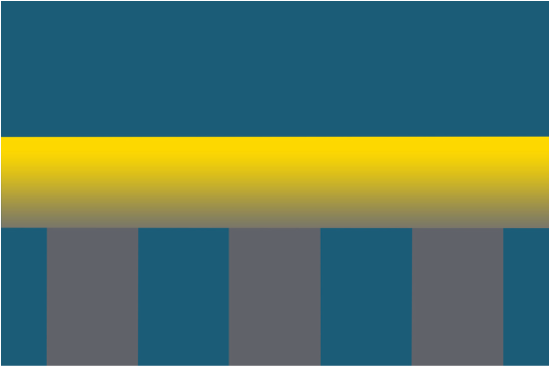
A Ted talk was given by Roman Mars, a pod caster of the show 99% Invisible and enthusiast about flags. This Ted talk highlighted the importance of flags and images of several city flags were shown. When you think of country flags, you should keep in mind, city flags as well. As my attention was drawn to the city flags of the world, I instantly had favorites (Hong Kong's flag is just too amazing). I kept in mind the flag project as the Ted talk continued and paid heed to Ted Kaye's five key principles in making a good flag from his book, Good flag, Bad Flag: How to Design a Great Flag. These principles were the guidelines for me to start work on my flag. This would be my flag of Milwaukee. Having seen the flag of Milwaukee, I could only hope someone wins the competition this time around.
The five key characteristics as stated by Ted Kaye were:
Keep it simple. A child should be able to draw it from memory.
Use 2-3 basic colors.
Have meaningful symbolism
Be distinctive.
Have no letters
I took these 5 characteristics into consideration and started planning. On the previous flag, there was a gear for the industry, a wheat stalk symbolizing the strong brewery industry, waves for the harbor and those are the things that I mainly focused on. I did not really look at the current flag much but I knew what was on it. I live in Milwaukee and I knew what the city had to offer and that would make a solid flag.

Slide 15
The program that I used for this project was Adobe Photoshop CC. Being a beginner in Photoshop, I did not know how to work it very well and I feel as if this project really aided in figuring out how to utilize Photoshop to make shapes and recolor objects. This was a very important skill that I wish I knew for my Digital Collage so I could change the colors of the watch straps. I also got to utilize the skills, I learned in completing my digital collage. I was more comfortable undoing steps and interacting with the different layers. I learned of blending options and the most important things I would say I learned is how to apply a gradient to a shape and construct shapes using the pen tool. For the pen tool I clicked equal distances and in a straight path with the aid of the ruler tool (Ctrl + r) I closed the path and another layer with the shape was created. I also learned to press alt-shift and click the shape if I want to duplicate it on the same layer which saved a ton of time! The gradient tool came in helpful when I wanted to incorporate unity between the two rectangles to the central rectangle or the columns of the bridge to the horizontal platform. For the Gradient tool, I right-clicked the layer the shape I wanted to apply a gradient was on and went to blending options. From there I went to Gradient overlay where I changed the colors to gold and gray. After I had one sketch done on Photoshop and then one more, the process became extremely easier.
Trying to make something look pleasing to look was the struggle that I faced throughout the entire. You have all these ideas which I sort of had to make and experiment with which took the longest time out of all tied with my frustration with Photoshop at the beginning. The meaning I had already got down and so far I was following the guidelines for the flag design so I was on track. There were little bumps in the road when I would forget what I did to make something happen on Photoshop and then I would need to repeat the same thing but I had forgotten how. Researching on the internet helped a lot with this confusion. Next up were the choices for color. I had to choose the hues for the colors. This took a lot of experimenting and the colors that I utilized are listed on top of all my flags below.
The flag I chose out of all the bottom ones is the one on the lower-right hand corner because its the one in which the hues complement each other the most. The gold is really emphasized and gives the flag a color that stands out and catches the eye. I feel as if the flag with purple in it was not as successful as all the others because the story behind should go deeper than the state flower. There needed to be attention paid to specific areas of Milwaukee. The idea with the two columns and central column was too simple for my liking. This left the flag that incorporated the bridge idea. I experimented with placing the horizontal bridge column equally in the middle very last moment and I liked that better than when the column was unequally placed. It gives the flag a sense of balance and the columns do not look so thin. Now with the color, I had the most trouble with the gray and blue. (too much information for this piece)

Slide 16
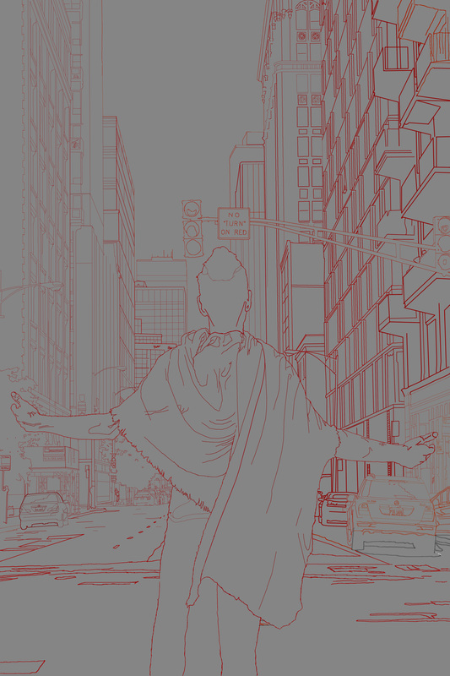
Over the summer, I developed my photoshop and digital art skills but did not have an opportunity to showcase them until this piece. The piece began with a photograph permission from a friend (Thank you Than). The picture of myself is one that I took myself. I wanted to incorporate myself in order to create a personalized feeling as I have emigrated from India and seeing skyscrapers and such a large amount of cars was a surprise to me 11 years ago. The process of the piece begins in photoshop. First, I opened both pictures and created a new layer for the landscape so the background does not stay locked and I can manipulate it as I want. Then, I used quick select to outline myself and copy it onto the landscape picture. From there, I created more layers on which I chose multiply, so solid color does not block the underlying layers from being visible. I began to outline the picture. It was very daunting as the size of the picture is tremendously big ( three times the size of my 91cm x 91cm self-portrait). However, I was adamant on incorporating all the detail I could given the time constraints. In the future, I plan on adding color by using a brush-preset. With this, I will be able to blend and become familiar with photoshop painting, something I have not painted with before.
Pietro Perugino was one of the foremost artists of the Renaissance Period. As perspective was realatively new, Pietro succeeded in promoting perspective with the fresco above, now at the Sistine Chapel. An attempt to achieve perspective could be seen with Carolingian art, art from the 780-900s. However, perspective was denoted to be connected with size but the paintings were interconnected with numerous scenes (sort of like a panorama without form). Revisiting old text and knowledge, mathematics was utilised to discover one-point persprective which soon became popular due to its effect of representing one cohesive scene. In Perugino's piece one can see the effect of one-point perspective as it gives the viewer the illusion of depth. Alluding to Christianity with the title of the piece and the characters, Pietro situated the characters accurately in the foreground, with the rest of the lively crowd in the mid-ground and the structures in the background. This allows the viewer to ascertain the distance within the painting. The focal point of the painting is in the middle where the handing-off of keys is occurring. This is due to the size and the fact that is is right in the middle of the painting, allowing the audience's eyes to travel there instantly. Continuing, the audience makes their way towards the mid-ground and eventually the back-ground . The convergence point leads the movement of the eyes and adds movement to the piece.

Slide 17
In the future, if I am able to buy a good camera, I would like to continue taking pictures and transforming them into digital painting, where I feel as if, the artist has a lot more freedom and ability to convey ideas. Although taking a reference picture is not foreign to me as it is the initial step for most of my pieces (I need a reference somehow). Through this piece, I learned more about Photoshop. E.g. I did not know you could draw straight line by pressing shift and the brush tool. It was very helpful in creating large scale lines! I am looking forward to experimenting with different brush presets and effects as this picture will soon be colored.
So far, I feel as if I was successful in conveying my idea. The building juxtaposed with myself do seem daunting but with my arms outstretched I seem up to the challenge. There is similarity between my piece and Perugino's. It can be seen that both pieces have the people in the foreground with man-made structures in the background. There is distance between the structures and man in Perugino's work, insinuating a detachment from the structures and an attraction to other human beings. In Opportunity, there is one sole person looking toward man-made structures for opportunities. The painting cannot be comparing to this piece's preliminary stage. If this piece is to be completed successfully, then it must emulate Perugino's technique in a sense. I will aim towards achieving smooth, realistic folds in the fabric and accurate representations of the buildings.

Slide 18
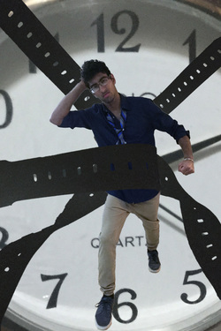
This was a very lengthy process in which I got pretty frustrated. It was also a very long process which I spent an all nighter doing. For the results of this work, there were many so called final projects (three). The first one was one that I despised so so much. The Second one would suffice but it was really not what I was aiming for. I believe the third one, which is the one on the top of this page, is my final result and I do not hate it but it could definitely be better with a greater knowledge of the software, Photoshop CC.
First, I received the loose guideline the digital collage had to represent, it had to be something about you. I sat down and thought about a simple idea I wanted to convey across using digital manipulation. I started sketching right away and I drew a vague figure in motion with these vines holding them. The motion in the picture definitely drew me towards Longo and after a little bit more thinking I started to figure out the details, I wanted to incorporate. I took a little bit of a surrealist approach and thought of Salvador Dali and Magritte with the clock. Originally I wanted the clock to be hiding my face and somehow I also wanted a silhouette of my body filled with ashes. There would have been two hands, each holding onto a 'vine' in which they would be pulling me in two opposite directions. These were a lot of ideas and I did not have the time to play around with them. I stuck with Longo because he wanted to project the menace and violence of city at night. I took the negative emotions that he wanted to portray and utilized them illustrate the boy's struggle against time.
Inspired by Robert Longo's 'American Psycho', this digital collage incorporates the struggle against time. The boy is frustrated as he is restricted by the watch straps. The straps have him 'stuck' as he is trying to move. The watch in the background is a reminder that time plays a huge role in the life of this boy. The tie is disheveled and the fist clenched indicating the conflict with time. He is shown upset as the straps keep him immobilized, as time continues moving.

Slide 19
The next day, I began to work on my project again. I hated what I had created. To get rid of the flashy look, I used a different wristwatch which was less intricate and bold. I decided to ditch the metallic watchstraps and use the watchstraps of a white plastic wristwatch that I have. I did not like the color white however so I took a picture of a leather shoe so I could replace the white. I took pictures of the watch in different positions (straight, curved, spiraled) so I did not have to mess around with puppet warp. I began working on Photoshop again, using the quick selection tool and refining the edges of the objects I had selected. I did not have to mess around with color which was great. However, replacing the white with the leather was not as simple as I had thought it was and I spent a lot of time going around in circles. I had to use a layer mask, click 'reveal all' and simple copy and paste. I figured out how to replace the texture of one of the watch straps and then as soon as I was about to begin on the few more I had left, I had forgotten or done a misstep. Eventually, I figured it out and at that point as soon as all the objects were on one background layer, I was 'finished'.
After a week or so, after being told by a friend that my watchstraps look like seaweed, I decided to revisit my digital collage again. I used a different texture (of a belt) and this time around made sure I took the picture without the reflection of an artificial light source. So, it was back to the shop again. I thought to myself about how I had to do the texture all over again and what a pain it was last time. It had been a while and I didn't even remember exactly how I did what I did last time but this time, by a stroke of luck, the process was even easier. To put the leather texture on top of my white watchstrap, I simply clicked 'create clipping mask' and viola! It had been done. After that, I changed the position of straps and myself slightly and re-sized some aspects.
I feel as if I conveyed my message. I label this project successful. Is it perfect? No. It was a new medium that I worked with for the very first time and taking into consideration that fact, I think I did a decent job. A couple things I like about the final result is the background and the positioning of myself in the picture. The work has balance and I like the simplicity it has with just three things popping out: the watch head, myself, and the watchstraps. The color is a very dark brown and almost indistinguishable from black. I wish I could've made it brown. The quick selection around the left watchstrap was not perfect and it looks choppy and unnatural. I would like to improve that. I also want the watch straps to look like they are actually wrapping around me and grabbing me, pulling me to the ground. The ideas are all there but the execution definitely needs work. This level of successful can be obtained with increased knowledge of Photoshop CC and time.

Slide 20
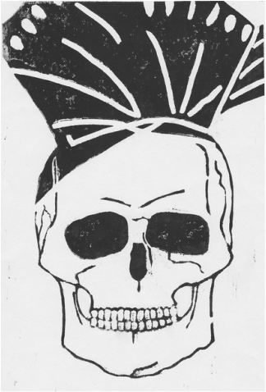
I had to find something that connected to me and my culture since one of themes I could choose from was culture. I quickly began thinking on how I could convey what I've felt for quite a while with never really being immersed in my culture as much as I should be. As soon as I came to the U.S my culture was becoming less and less a part of myself as I picked up a new language and the new culture of an unfamiliar country. For my first sketch, I drew a silhouette of a bhangra dancer. This piece had movement and I would carve away to reveal the negative space and the lines (positive space) would definitely show motion with their direction. For the second sketch I started thinking about body parts and what they can symbolize. I sketched out a heart but this idea was aloof and did not really concentrate on my theme. For the third sketch the idea of a skull came to me. It stuck with me because it would get my message across. The third and fourth sketch of a paggiri could be combined to become my final result. Kirchner was the fine artist I wanted to focus on since his goal "was always to express emotion and experience with large and simple forms and clear color." Since I was doing the medium of a block print, I decided this would be perfect to put emphasis on two aspects of my piece: the skull and paggiri.
Inspired by Alex Kirchner, this piece tries to convey the death of a culture through a 'paggiri' and a skull. The paggiri is a symbol of the Sikh culture whereas the skull stands as an universal symbol of death. The simplicity of the piece should yell out at the viewer. The skull's harsh lines and lots of negative space balance out with the positive space on top of the piece. The paggiri draws attention to the top then the eyes take in the entire piece.

Slide 21
​﻿​The X-Acto Knife really does deserve its own title. This tool helped me immeasurably in creating my block print! I envisioned my final result to have crisp corners and several lines that would need to be in close proximity with each other for the effect of the cracks on the skull. I couldn't achieve that with the other tools so I used an X-Acto Knife. I had already did the rough parts in my block print and only the brushing up and corners need to be done. I used the knife to make several thin cuts into the linoleum and then I would insert the knife beneath the linoleum at about a 10 degree angle with the table I was working on. This would carve the linoleum from the block and my crisp corners where the lines met would be created. I repeated this process many times, especially for the teeth.
I sketched a skull on the block and on it drew the details: the shadows, dips, indents. When I first started carving with the carving tools, I found it quite easy to carve into the block. I started from the forehead since there was a lot of negative space to be created there. I ditched the idea of showing value through this piece because I realized showing detail through this process was close to impossible. I would have needed quite a few more hours and would have had to ditch the carving tools, using only an X-Acto Knife to make thin straight lines for cross-hatching. To that, I said no thank you. After the forehead, I began on the teeth because they looked so daunting and I really wanted to get it over with. I began with carving small squares in the linoleum, spacing them apart sparsely. I took great care with the teeth and both hands to stabilize the pressure I carved the linoleum with. The next step was defining the nose and eyes of the skull. Now this, required even more care and I used a finer linoleum carver for this procedure. I defined the features roughly and whenever I would encroach upon another feature, I would stop. Next up was outlining the skull for which I used a broader linoleum carving tool and just sped up the process. I created the negative space around the skull in straight lines, trying to keep the same pressure so I would not have ink on some of the ridges that might be created with strayed, accidental movement which led to crooked lines and varying pressure. The paggiri was relatively easy for me to do but I had to sacrifice the many folds of the cloth for only a few since I did not have the precision they demanded. The printing went easily. The ink cooperated and although my print is not perfect, I believe that ink was applied to the most important areas and I am content with that. It was refreshing to print because carving was starting to get real old.
There was a lot of time invested in this project and I feel as if I was successful with it. The major component was carving and after that printing went smoothly. The end result was definitely not a surprise to me considering I had it in mind all along. I met my goals on this project and the piece has balance, contrast, and emphasis. The balance is created with the black headpiece and the white skull. This also adds emphasis on the both pieces depending on how the viewer depicts it. Contrast is also created with only the use of black and white along with the thickness and thinness of lines. The thicker lines represent less detail. However, they are bigger in size so they also retain a sense of importance whereas the thin lines are miniature compared to the others but this should have the viewer pay more attention to the skull. The skull and headpiece keep this balance between themselves. (too much info)

Slide 22
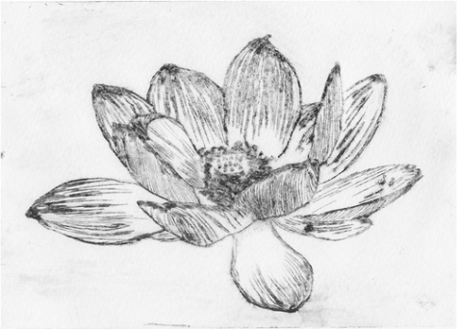
I began with a very rough sketch of the lotus flower which I immediately turned into a detail sketch that was in proportion to my dry point. I placed the dry point plate above the detail sketch with tape. Carving began with the bottom most petal which was in a way is the experimental petal. I found etching to be difficult to control and found out that the point of the tool is a rough triangle. I put less pressure, more pressure and changed my grip many times. Then I continued to outline the lotus. Giving value to the flower, was not so difficult but it was done with less caution and accuracy because at that point my finger was aching terribly with hours of holding the tool and a callus had formed (still here). The lines were etched on straight with varying room between to show different degrees of value. Georgia O'Keefe was the ideal artist as she blended precision with abstractness. The entire focus of her work is flowers and that shouts life at you, or at least it did for me. Although precision is evident in my work, abstractness is not.
'New' is the representation of life. Flowers bloom where some things have died out. The detail in the piece and the value shows a fragile beautiful flower. ​This is a continuation of the block print 'Identity'. In sharp contrast to 'Identity', 'New' features a flower to indicate the birth of new ideas and a new culture that takes over the old. Georgia O'Keeffe's paintings of large flowers and Rousseau's realistic paintings inspired this piece onto the medium of dry point.

Slide 23
I think my work could be better. I envisioned it to look neater and the outlines of the petals should not be outlines at all. I could've blended the lines better and as well as given more clarity towards the middle of the flower. The new medium was a challenge in the fact that attempting to show the intricate details was arduous. You definitely can achieve a lot more detail compared to block print but it is not enough for my taste. I would say this would have been better if I had more time but honestly, I doubt I would've spent more time on this troubling process. However, some aspects of my work I do find not terrible. The contrast in value can be seen and I like that. It was one of my goals and I'm glad it was achieved.
The middle of the flower took more time than the rest of the flower and the results were disappointing when I finally printed it. I started by working on one single filament at a time trying to experiment with the shading using cross-hatching and stippling. The picture from which I sketched from showed white on top of the filaments so I did not etch that much into the plastic towards the top. For the stigma of the lotus, I used cross-hatching more towards the outside with stippling to create a ridge that was naturally there. The ovules were constructed with stippling.
The printing process was the toughest process out of all but mostly I was disappointed with my prints because I had high hopes on really obtaining the level of detail I had pictured in my mind. For printing, I needed the necessary materials: newspaper, palette knife, latex gloves, bin with water, timer, card stock paper, ink and a roller. Newspaper was laid down on the table and then I proceeded to put on Latex Gloves and apply ink to my design using the palette knife. On the first try, I put on too much ink and taking it off was a lot of work. There were lots of newspapers sacrificed that day. Newspapers were torn and then folded. I applied ample pressure and wiped off. Several times. All throughout this time, the several card stock papers were in the water with the timer set for 8 minutes. I knew the papers would dry out if I finished wiping my ink off too late because either way the papers could not be left in the water for more than 8 minutes or else they would soak in more water than necessary. Around 8 minutes, they were taken out by a classmate that put them on a towel. I finished wiping the ink off a few minutes later. I moved on to the roller. My design went under the card stock paper and then I rolled it through. My first 3 prints were not good. They turned out blurry and one didn't show up at all (pretty sure I printed on the wrong side). The style and stigma of the lotus were nothing but a inky blur so I went back to etch deeper. The following day, I reprinted and timed everything correctly so the card stock papers were in the optimal conditions. My prints came out a little bit neater.

Slide 24
Extra

Slide 25
Extra 2

Slide 26
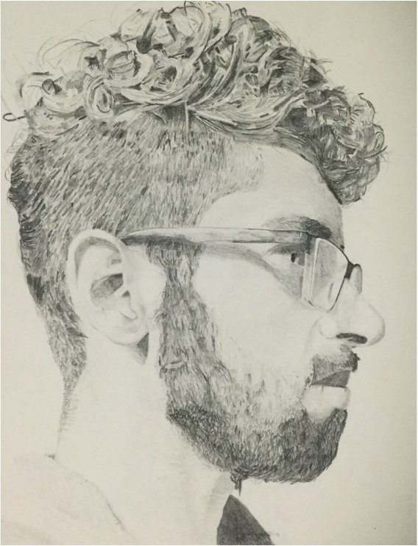
Overall Development as an artist

